Slide 1

Coastal Tourism website
Enhancing Coastal Tourism Safety in India through innovative technology. Ensuring a safer and more enjoyable experience for tourists along India's beautiful coastline.
Project Made By
22IT088 PARMAR SMIT
22IT099 PATEL MEET
22IT101 PATEL NIKHIL

Slide 2

Introduction: India's Coastal Tourism
Vibrant Tourism Sector
Significant GDP Contribution
A key contributor to India's economy.
Estimated at $25 billion annually.
Sustainable Development
Focus on tourism promotion.

Slide 3
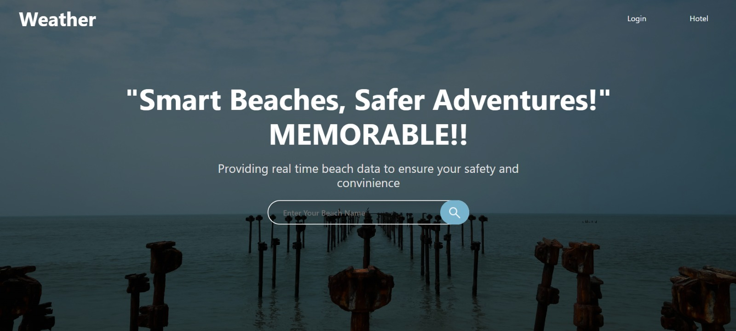

Slide 4




Problem Statement: Risks in Coastal Tourism
Coastal tourism faces risks like unpredictable weather, strong currents, and marine life. Drowning incidents are a significant concern, accounting for over 60,000 deaths annually in India. The lack of real-time information on beach conditions greatly affects tourist safety. Cyclones in Odisha and West Bengal disrupt coastal activities, causing safety hazards.
Unpredictable Weather
Strong Currents
Drowning Incidents

Slide 5
Project Objectives: Enhancing Tourist Safety
Real-Time Environmental Monitoring
Safety Alerts and Recommendations
User-Friendly Interface and Search Functionality
Comprehensive Data Presentation
Interactive Map Integration

Slide 6
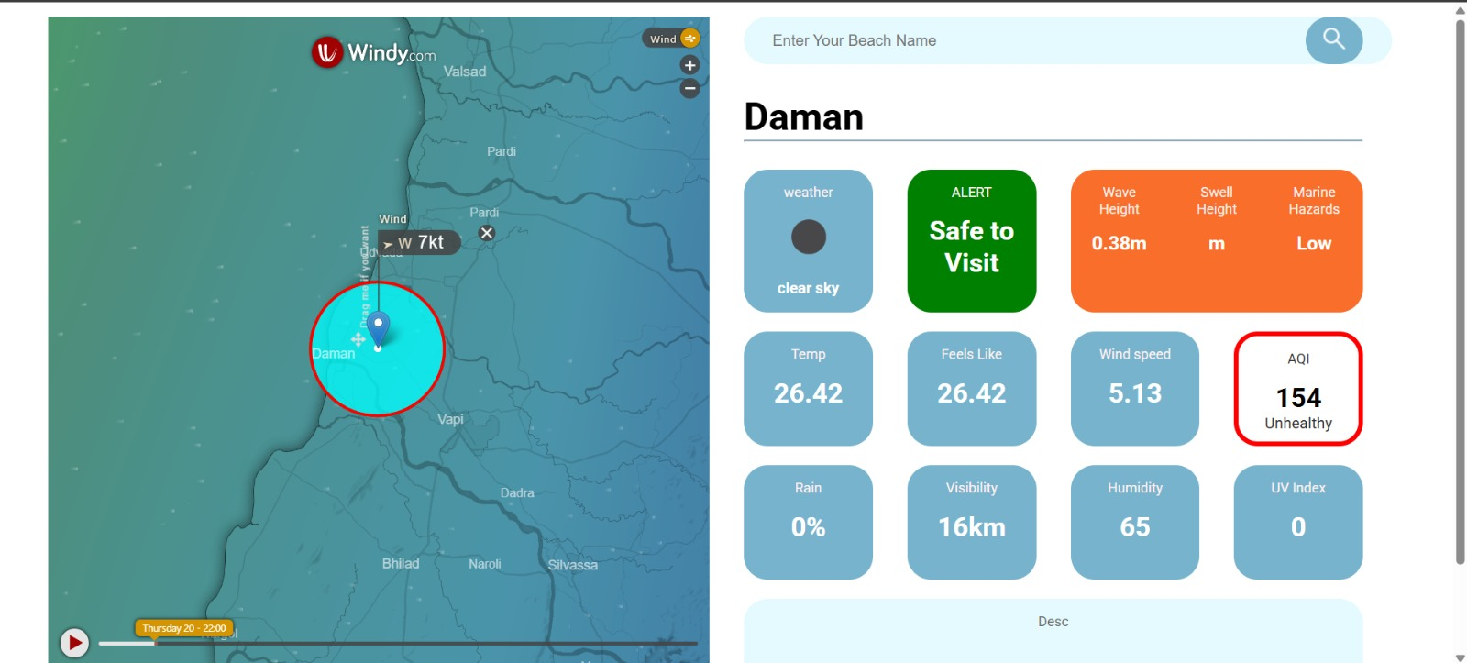

Slide 7
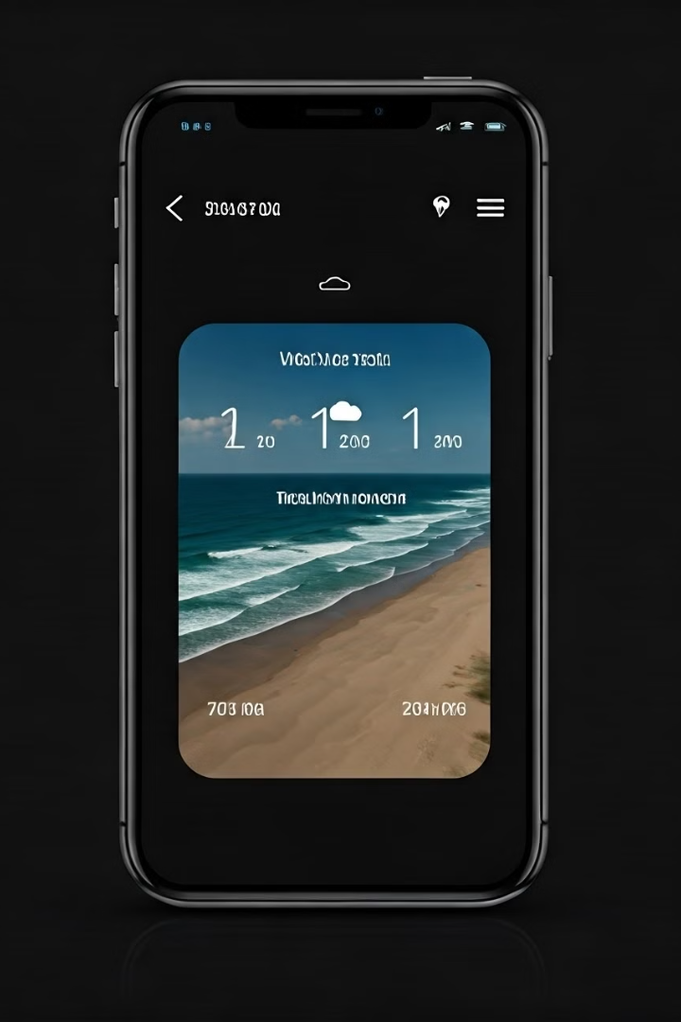



Proposed Solution: Beach Safety website Features
The Beach Safety website will offer real-time weather updates and forecasts using data from the India Meteorological Department. It will provide information on water conditions, including tide levels, currents, and wave height. Location-based alerts and warnings for hazardous conditions, a directory of emergency services, and multilingual support will also be featured.
Weather Updates
Aqi Updates
Location Alerts

Slide 8



Expected Impact: Economic and Social Benefits
This initiative will increase tourist confidence and satisfaction, reduce accidents, and improve safety records. It supports sustainable tourism practices and enhances India's reputation.
1
Increased Satisfaction
2
Accident Reduction
3
Sustainable Tourism

Slide 9




Conclusion: Towards Safer Coastal Tourism
The Beach Safety Website is a crucial step towards enhancing coastal tourism safety in India. We are committed to leveraging technology for the well-being of tourists
Commitment
Collaboration
Support

